Slide 1

Session Name:
Classification
of data
Delivered By:
Vikash Singh

Slide 2

Learning Objectives
By the end of this session, you will be able to:
Understand what data classification is and why it is important
Differentiate between different types of data classification
Construct both discrete and continuous frequency distributions

Slide 3




DY Patil Learner App
For Android Users:
Open the Google Play Store on your device and search for "DYP Learner App".
Tap the app from the search results and select Install.
Once installed, tap Open or locate the app on your home screen.
Log in using your LMS credentials.
👉 Download Now: Google Play Store Link
For iOS Users
Open the App Store on your device and search for "DYP Learner App".
Tap the app from the results and select Get to install.
Once installed, tap Open or find the app on your home screen.
Log in using your LMS credentials (registered email ID and LMS password).
👉 Download Now: App Store Link

Slide 4
What is Data Classification?
Definition:
Data classification is the process of organizing data into categories for more efficient analysis and interpretation.
Purpose:
Simplifies large datasets for better understanding
Helps identify patterns, relationships, and trends
Real-World Example:
Classifying customer ages into different age groups for a marketing campaign

Slide 5
Types of Data Classification
1. Qualitative Classification: Based on attributes like color, gender, or type
2. Quantitative Classification: Based on numerical values
3. Geographical Classification: Based on location or region
4. Chronological Classification: Based on time

Slide 6








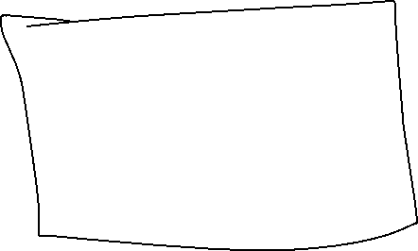




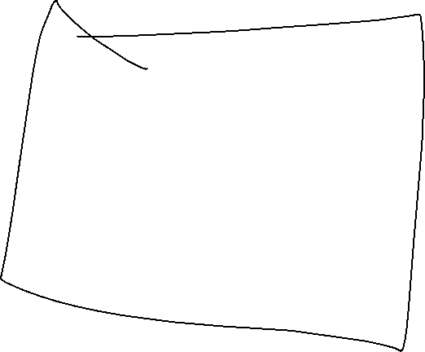

Introduction to Frequency Distribution
Definition:
- A frequency distribution is a table that shows the number of observations (frequency) in each category or interval.
Purpose:
- Summarizes large datasets into a compact format
- Facilitates comparison and pattern recognition
Types:
- Discrete Frequency Distribution: For discrete data with distinct values
- Continuous Frequency Distribution: For continuous data grouped into intervals

Slide 7
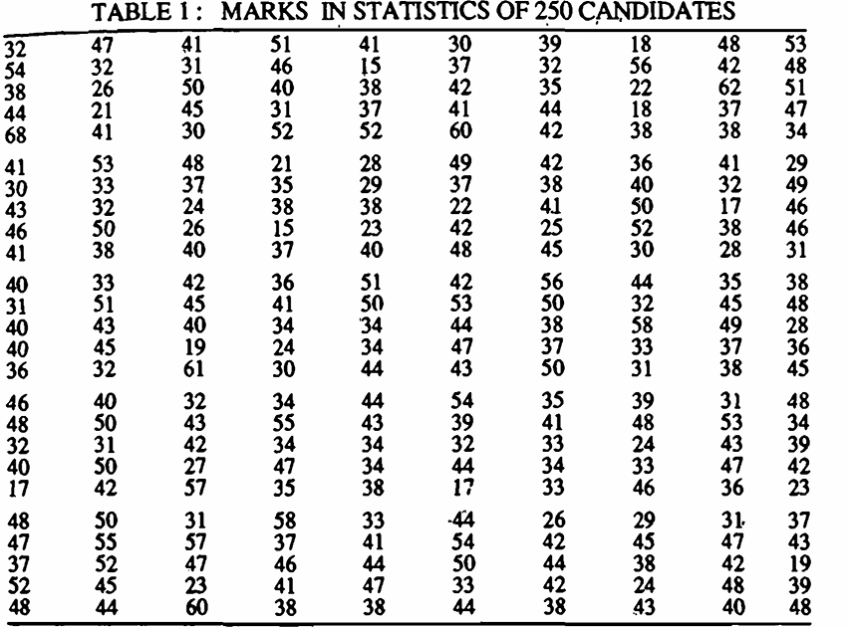
Introduction to Frequency Distribution Example
Let’s consider the marks in Statistics obtained by 250 candidates selected at random from among those appearing in a certain examination·.

Slide 8
Introduction to Frequency Distribution Example
This representation of, the data does not furnish any useful information and is rather confusing to mind.
How many students got 31 marks?

Slide 9
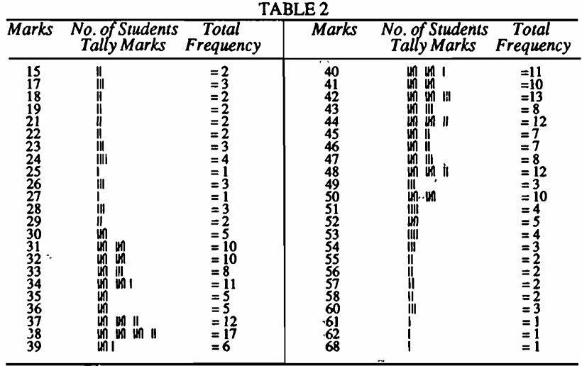





Introduction to Frequency Distribution Example
Frequency Distribution…
Marks are called the variables (say x)
And number of students against the marks is called the frequency (say f)

Slide 10
Introduction to Frequency Distribution Example
Frequency Distribution…
Marks are called the variables (say x)
And number of students against the marks is called the frequency (say f)
How many students got 31 marks?

Slide 11
Construction of a Discrete Frequency Distribution
Steps:
1. List all distinct data values (X)
2. Count the frequency (f) of each value
3. Record the values and frequencies in a table
Example:
Number of pets owned by 20 families: [0, 1, 2, 2, 3, 0, 1, 2, 3, 1, 1, 2, 3, 2, 0, 1, 2, 2, 3, 1]

Slide 12




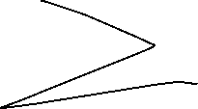
Construction of a Discrete Frequency Distribution
Example:
Number of pets owned by 20 families: [0, 1, 2, 2, 3, 0, 1, 2, 3, 1, 1, 2, 3, 2, 0, 1, 2, 2, 3, 1]
Pets (x) | Frequency (f)
0 | 3
1 | 6
2 | 7
3 | 4
Total: N=∑f=20

Slide 13
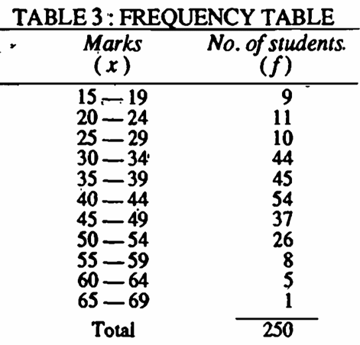
Grouped Frequency Distribution
The classes of the type `15-19`,
`20-24`,
`25-29` etc.,
in which both the upper and lower limits are included are called 'inclusive classes’ .
Classification is termed as inclusive type classification.

Slide 14
Points to consider while creating classes
The classes should be clearly defined and should not lead to any ambiguity. 15 – 20, 20 - 25
The classes should be exhaustive, i.e., each of the given values should be included in one of the classes.
The classes should be mutually exclusive and non-overlapping.
The classes should ideally be of equal width. The principle, however, is not something that is written in stone.

Slide 15
Points to consider while creating classes
Indeterminate classes, i.e., the open-end classes. less than 'a' or greater than 'b' should be avoided as far as possible since they create difficulty in analysis and interpretation.
The number of classes should neither be too large nor too small. It should preferably lie between 5 and 15.
The following formula due to Struges may be used to determine an approximate number k of classes :
k = 1 + 3·322log10N
where N is the total frequency.

Slide 16
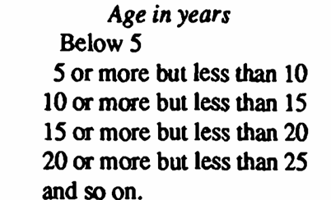
Continuous Frequency Distribution
If class intervals are 15-19, 20-24 then the persons with ages between 19 and 20 years are not taken into consideration.
In such cases..?

Slide 17
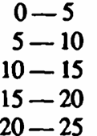








Continuous Frequency Distribution
This form of frequency distribution is known as continuous frequency distribution.

Slide 18
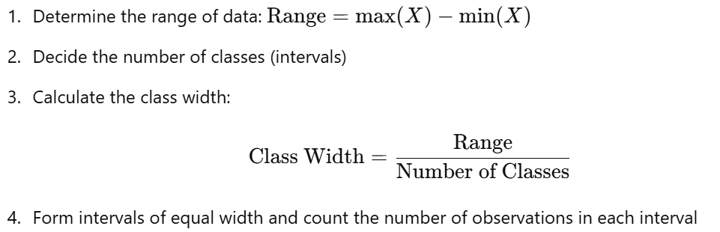
Construction of a Continuous Frequency Distribution
Example: Ages of 30 employees:

Slide 19
Construction of a Continuous Frequency Distribution
Range: ?
Number of Classes: 5 lets say
Class width = ?

Slide 20
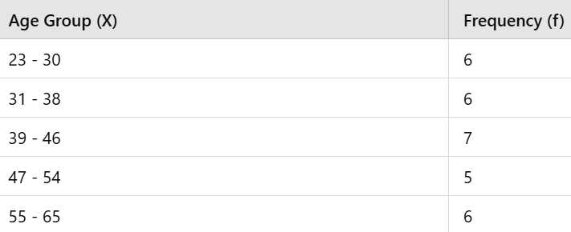
Construction of a Continuous Frequency Distribution
Range: 65−23=42
Number of Classes: 5 lets say
Class width = 42 / 5 = 8.4 – round to 8
N=∑f=30

Slide 21
Quiz
Q1: Which of the following is NOT a type of data classification?
A) Qualitative
B) Quantitative
C) Alphabetical
D) Geographical
Q2: The frequency of a data value represents:
A) The average value of data
B) The number of times the value occurs
C) The sum of all data values
D) The difference between maximum and minimum values

Slide 22
Quiz
Q1: Which of the following is NOT a type of data classification?
A) Qualitative
B) Quantitative
C) Alphabetical
D) Geographical
Q2: The frequency of a data value represents:
A) The average value of data
B) The number of times the value occurs
C) The sum of all data values
D) The difference between maximum and minimum values

Slide 23
Categorical or qualitative
Nominal
Ordinal

Slide 24
Quiz
Q3: In a continuous frequency distribution, the class width is calculated as:
A) Range / Number of Classes
B) Maximum Value - Minimum Value
C) Frequency / Total Number of Data Points
D) Sum of Frequencies / Number of Classes
Q4: The most frequently occurring data value is called:
A) Mean
B) Median
C) Mode
D) Range

Slide 25
Quiz
Q3: In a continuous frequency distribution, the class width is calculated as:
A) Range / Number of Classes
B) Maximum Value - Minimum Value
C) Frequency / Total Number of Data Points
D) Sum of Frequencies / Number of Classes
Answer: A
Q4: The most frequently occurring data value is called:
A) Mean
B) Median
C) Mode
D) Range
Answer: C

Slide 26
Session Summary
Data classification simplifies complex datasets
Frequency distributions organize data into discrete or continuous groups
How to construct discrete and continuous frequency distributions
Frequency distributions are essential for identifying trends and patterns
In this session, we have discussed about:

Slide 27

Happy Learning

